Slide 1
Least-Significant-Bit Steganography: Text Hiding and Watermarking
Hunter Moore
CSCI 6397 -- Special Topics: Image Processing
University of Central Arkansas

Slide 2
Table of Contents
Introduction
Abstract
Experimental Results

Slide 3
Introduction – What is Steganography?
Steganography is the practice of embedding message data (text, image, audio, etc.) within a target data file such that it is imperceptible to the human visual system.
This distinguishes steganography from cryptography, where the observer can detect that a hidden message exists but may or may not have the means or knowledge required to extract it.

Slide 4
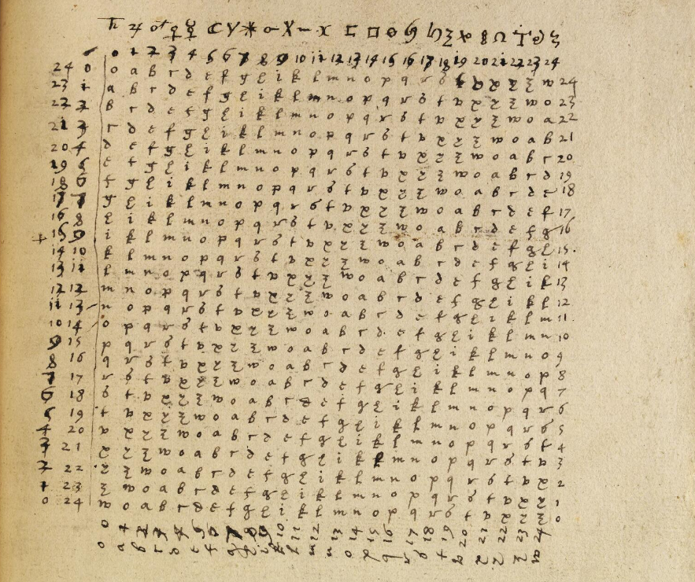
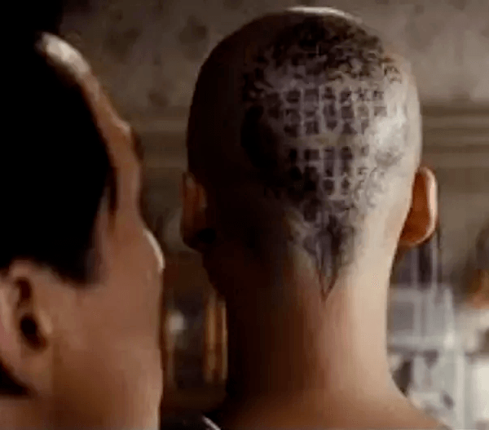
Introduction – Applications of Steganography
Physical Steganography dates as far back as 5th century BC—
King Histiaeus tattooed a warning onto a courier’s scalp of an impending Persian invasion. When the courier’s hair grew back, the message was obscured.
The first use of the term steganography stems appears in 1499 in Steganographia by Johannes Trithemius – a treatise on cryptography and steganography disguised as a book about magic and communication with spirits.
Modern Applications
Digital Watermarking
Printing
Secure Communications
Recreation --alternate-reality games (Cicada 3301)

Slide 5
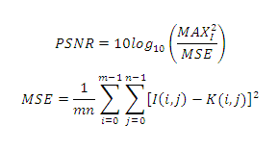
Abstract
Text Hiding and watermarking steganography were implemented using LSB as the embedding function.
Original and stego images were evaluated using Mean Square Error (MSE) and Peak Signal to Noise Ratio (PSNR).

Slide 6
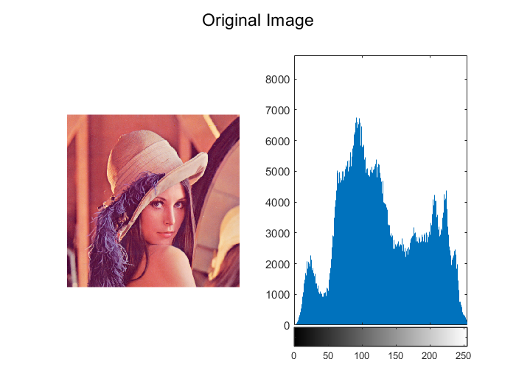
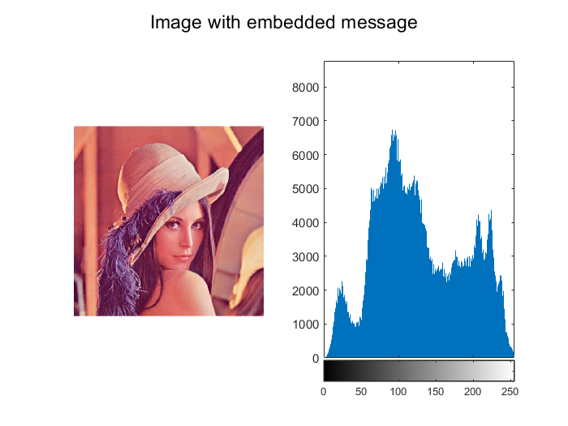
Experimental Results – Text Hiding
Input message is: Hello! This is a secret message.
Output message is: Hello! This is a secret message.
MSE: 0.000172
MSE: 0.000000
MSE: 0.000000
PSNR: 37.653274

Slide 7
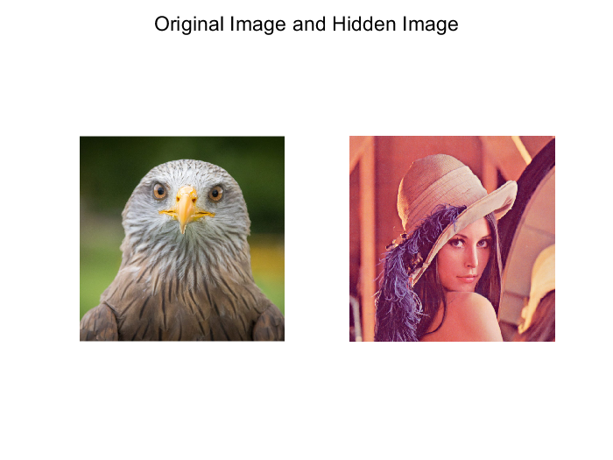
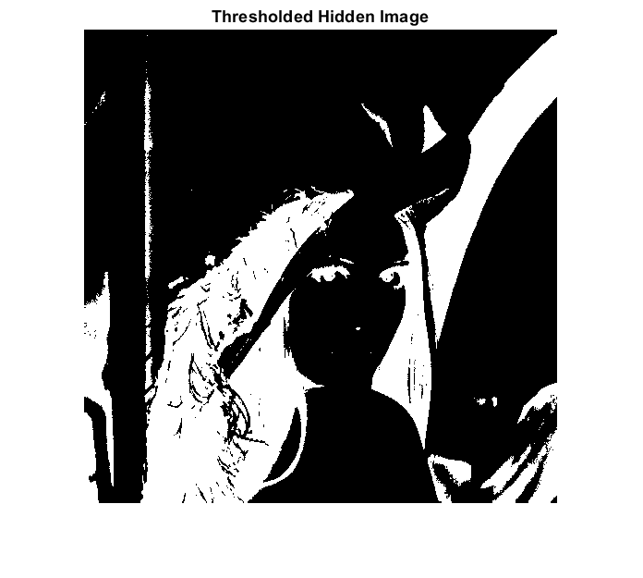
Experimental Results- Image Hiding

Slide 8
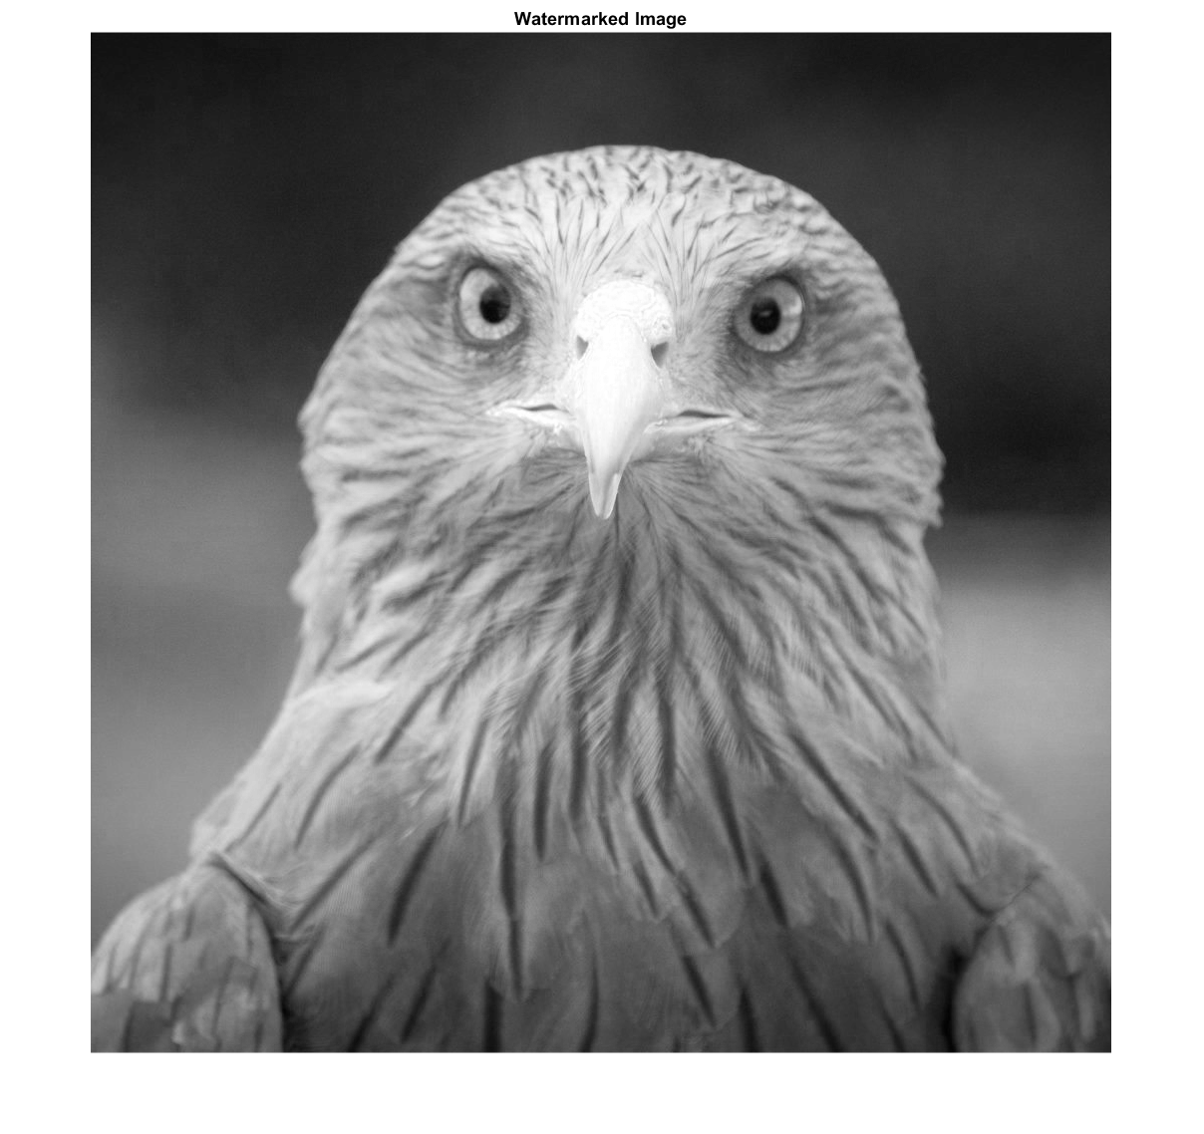
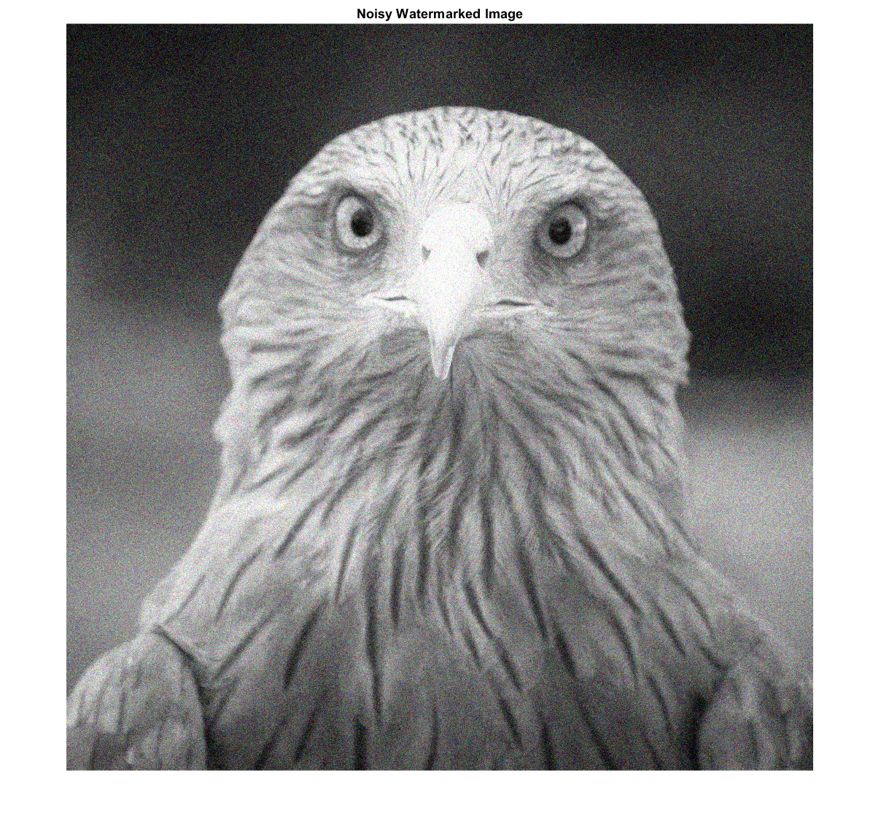
Experimental Results – Image Hiding

Slide 9
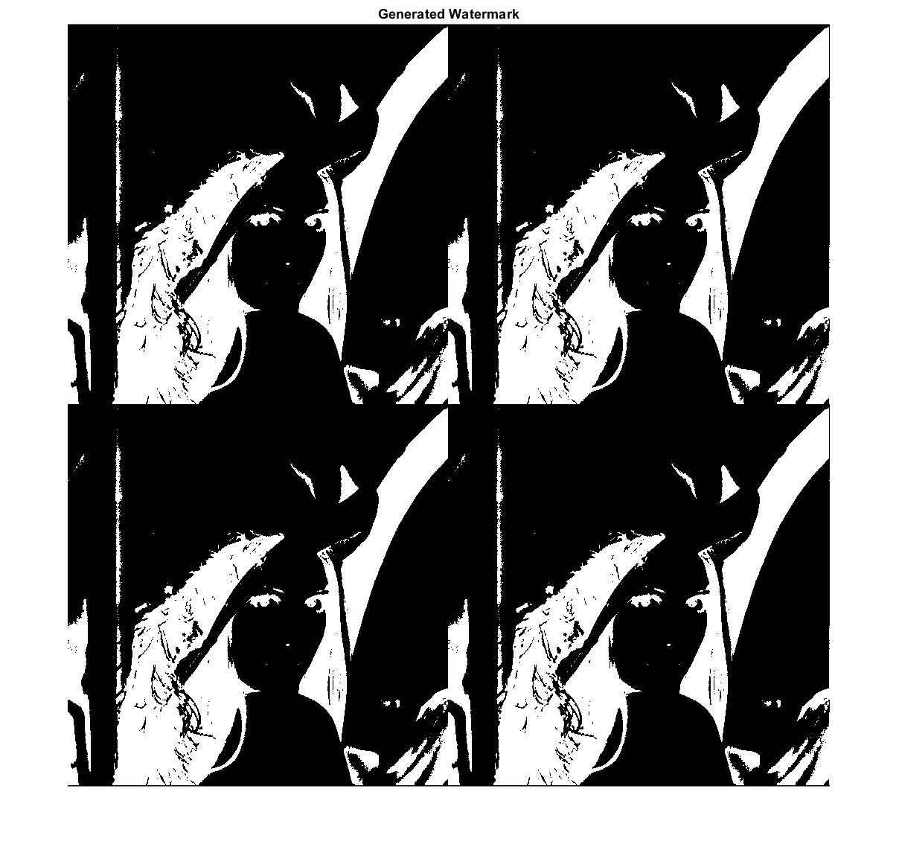

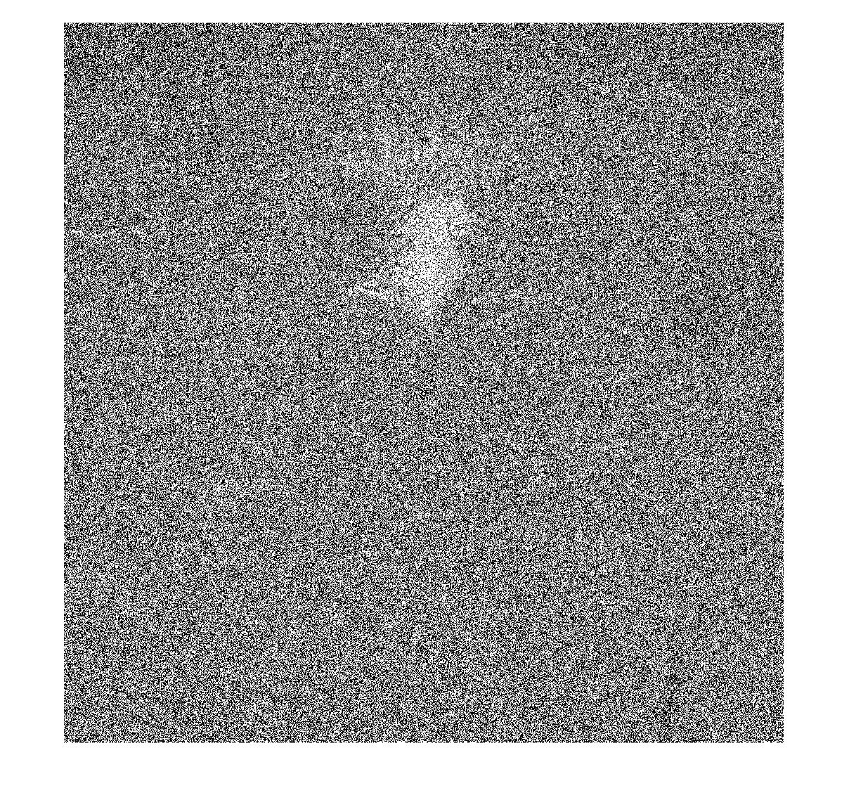
Experimental Results – Image Hiding
please select the target bitplane: 1
MSE of noiseless watermarked image: 0.166708
MSE of noiseless watermarked image: 90.014960
MSE of noiseless watermarked image: 505.959275
PSNR of noiseless watermarked image: -27.753489
MSE of noisy watermarked image: 216.075093
MSE of noisy watermarked image: 311.455146
MSE of noisy watermarked image: 812.826475
PSNR of noiseless watermarked image: -31.272204

